Slide 1

CAR PRICE PREDICTION PROJECT
SUBMITTED BY:
JASMINE KAUR
DATA SCIENCE INTERN
FLIP ROBO TECHNOLOGIES

Slide 2
PROBLEM STATEMENT
With the covid 19 impact in the market, we have seen lot of changes in the car market. Now some cars are in demand hence making them costly and some are not in demand hence cheaper.
One of our clients works with small traders, who sell used cars. With the change in market due to covid 19 impact, our client is facing problems with their previous car price valuation machine learning models.
So, they are looking for new machine learning models from new data. We have to make car price valuation model

Slide 3
COLLECTING THE DATA
We collected the data from the website of cars24.
We scraped data using selenium.
We received 2324 data points for the data.
The dependent variable is the price of the car.
The independent variables are fuel, transmission, km driven, year and model of the car.

Slide 4
UNDERSTANDING THE PROBLEM
This machine learning problem is characterized as supervised learning.
SUPERVISED LEARNING: In supervised learning, we are given a dataset along with the correct output , and thus we are able to find a relationship between input and output.
REGRESSION PROBLEM: As we dealing with continuous target variable, it means that our goal to map input variable to some continuous function. This is called regression problem.

Slide 5
BUSINESS GOAL
We are required to model the price of cars with the available independent variables.
This model will then be used by the management to understand how exactly the prices vary with the variables.
Further, the model will be a good way for the management to understand the pricing dynamics of a new market.

Slide 6
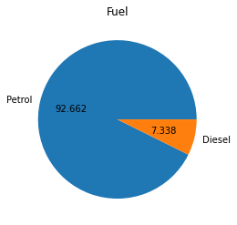
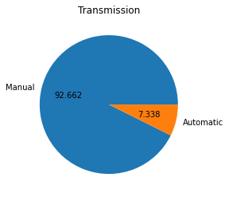
DISTRIBUTION OF CATEGORICAL DATA
FUEL
TRANSMISSION

Slide 7
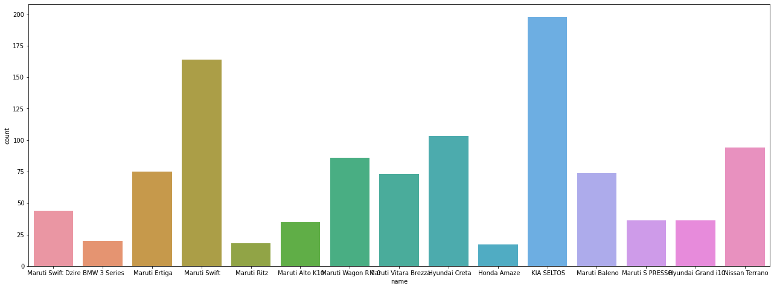
DISTRIBUTION OF CAR MODELS

Slide 8
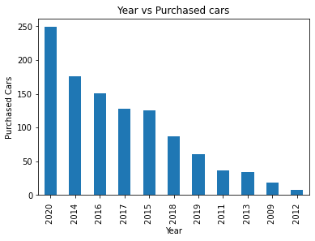
YEARS VS PURCHASED CARS

Slide 9
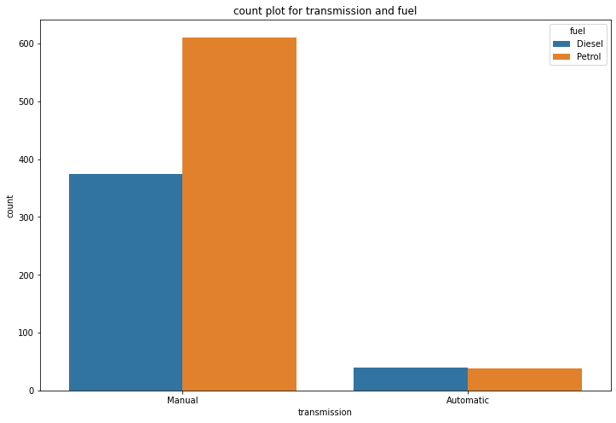
COUNT PLOT FOR TRANSMISSION AND FUEL

Slide 10
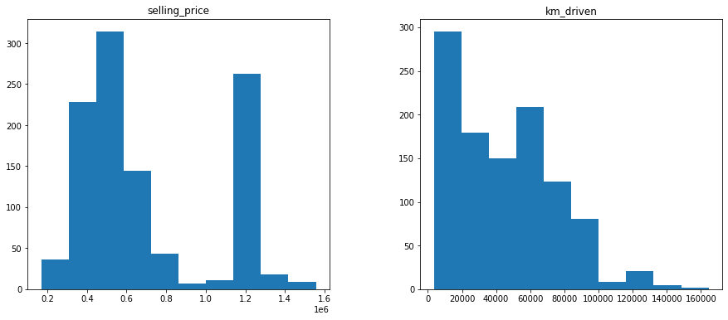
DISTRIBUTION OF CONTINUOUS DATA

Slide 11
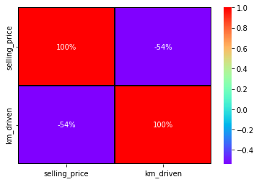
CORRELATION MATRIX

Slide 12
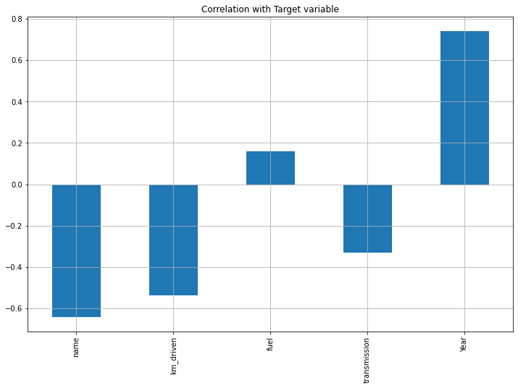
RELATION WITH FEATURES

Slide 13
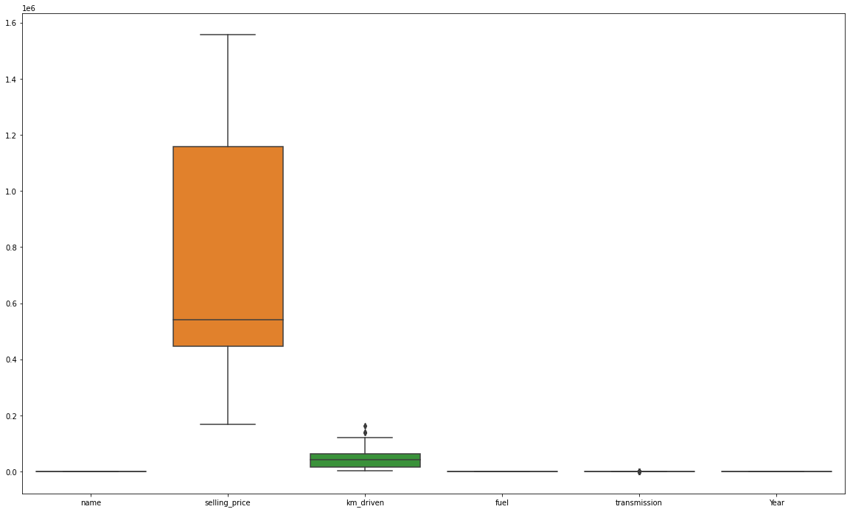
BOXPLOT

Slide 14
SKEWNESS AND OUTLIERS
The data is not skewed, so there is no problem of skewness.
There were some outliers, so we have applied IQR and this leads to 7% loss of data. This is acceptable.
There is no problem of multicollinearity in the data.

Slide 15
TOOLS USED
Hardware: 4 GB RAM, Intel 13 processor
Software:
Anaconda(64 bit)
Jupytor notebook
Python
MS-Office
Google Chrome Web Browser

Slide 16
ALGORITHMS USED
1. Random Forest Regressor
2. Gradient Boosting Regressor
3. Knearest Neighbors Regressor
4. Linear Regression

Slide 17
EVALUATION
R2 SCORE(COEFFICIENT OF DETERMINATION): It is the proportion variation in the dependent variable that is predictable from the independent variables.
MEAN SQUARE ERROR(MSE): MSE calculates mean or average of the squared differences between predicted and expected target variable in a dataset.

Slide 18
REGRESSION ALGORITHM RESULTS
MODELLING ALGORITHM | R2 SCORE
LINEAR REGRESSION | 0.802336
RANDOM FOREST | 0.998455
KNEAREST NEIGHBORS | 0.916056
GRADIENT BOOSTING | 0.991785

Slide 19
CROSS VALIDATION SCORE
MODELLING ALGORITHM | R2 SCORE
LINEAR REGRESSION | 0.657514
RANDOM FOREST | 0.989432
KNEAREST NEIGHBORS | 0.762045
GRADIENT BOOSTING | 0.979396

Slide 20
INTERPRETATION OF RESULTS
The difference between the r2 score and cv score is minimum for the Random Forest Regressor.
So, we will apply hyperparameter tuning on Random Forest Regressor.
After applying grid search CV, we got 89% r2 score which is 10% less than the original model, so we saved the model with default parameters.

Slide 21
CONCLUSION
We have got insights about collecting the data and then using to solve real life problems.
Performing data cleaning, data pre-processing are difficult but interesting steps in the process of reaching the end goal.
Machine learning models help us in predicting the dependent variable with the help of independent variables.
We have finalised Random Forest as the best model and saved it in pkl format.

